Slide 1
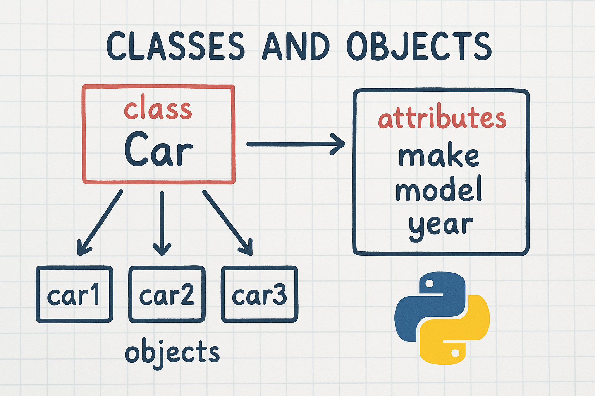
Classes and Objects

Slide 2
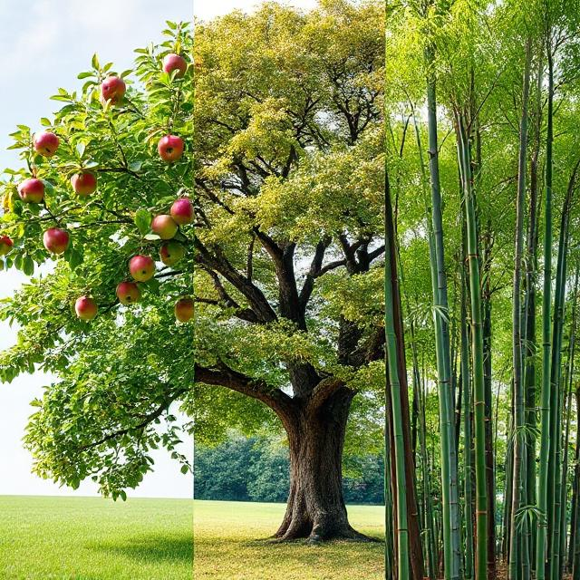
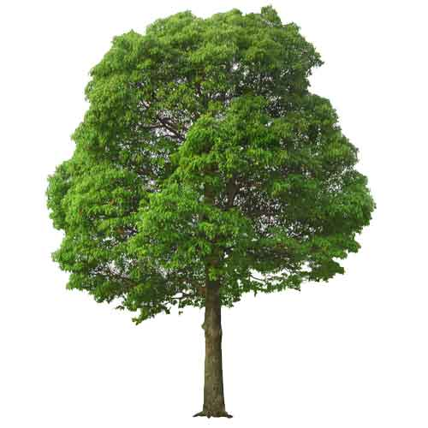
Apple
OAK
Bamboo
Class : Tree
Objects

Slide 3
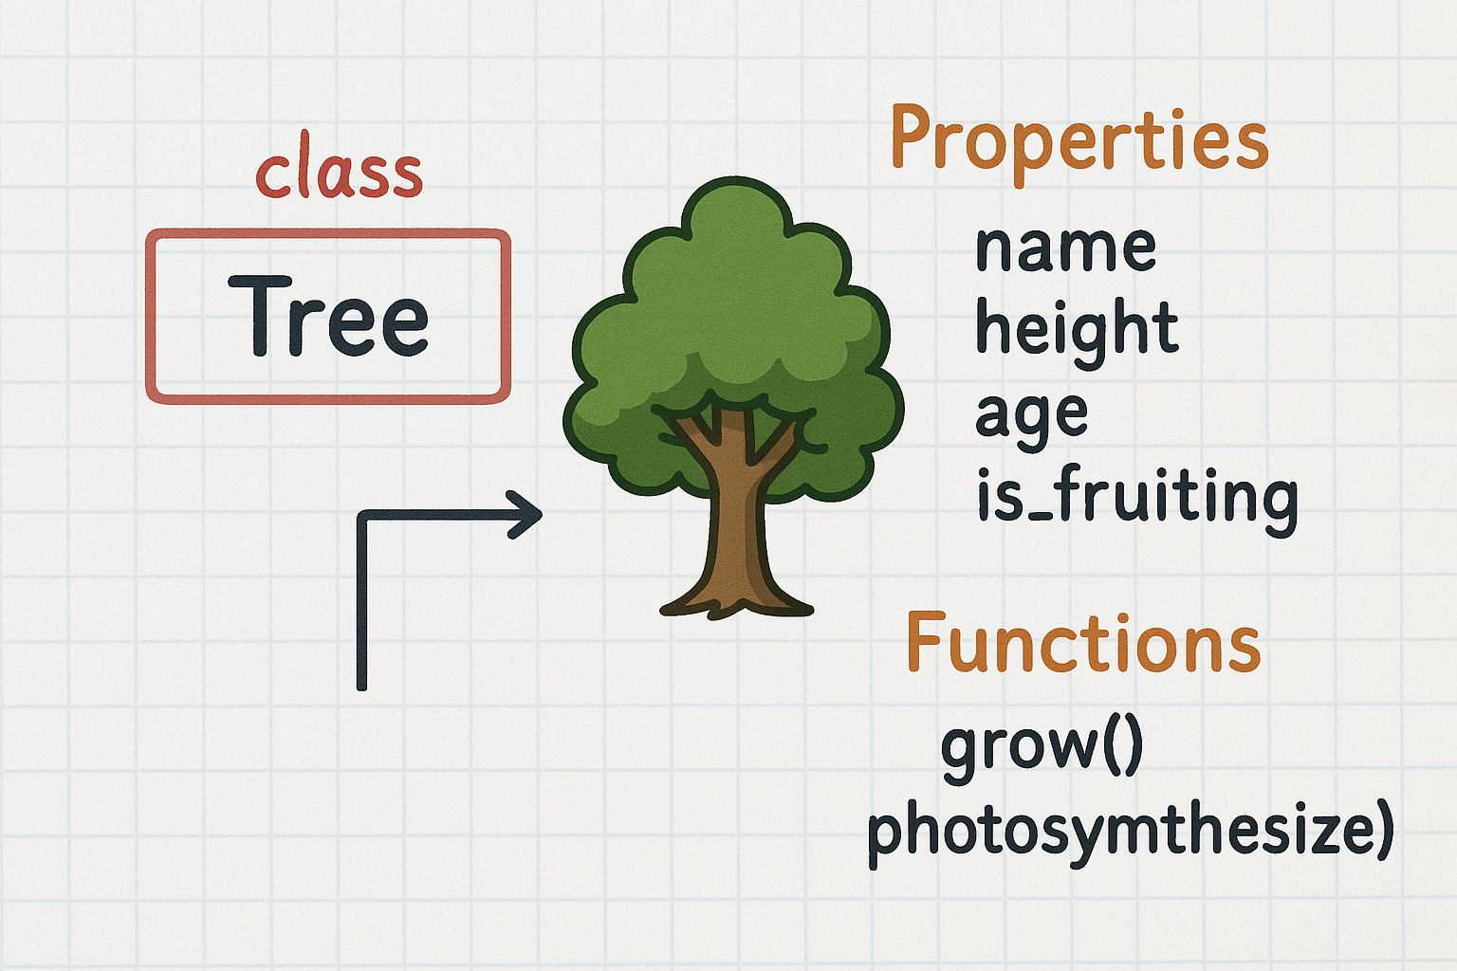
Class

Slide 4
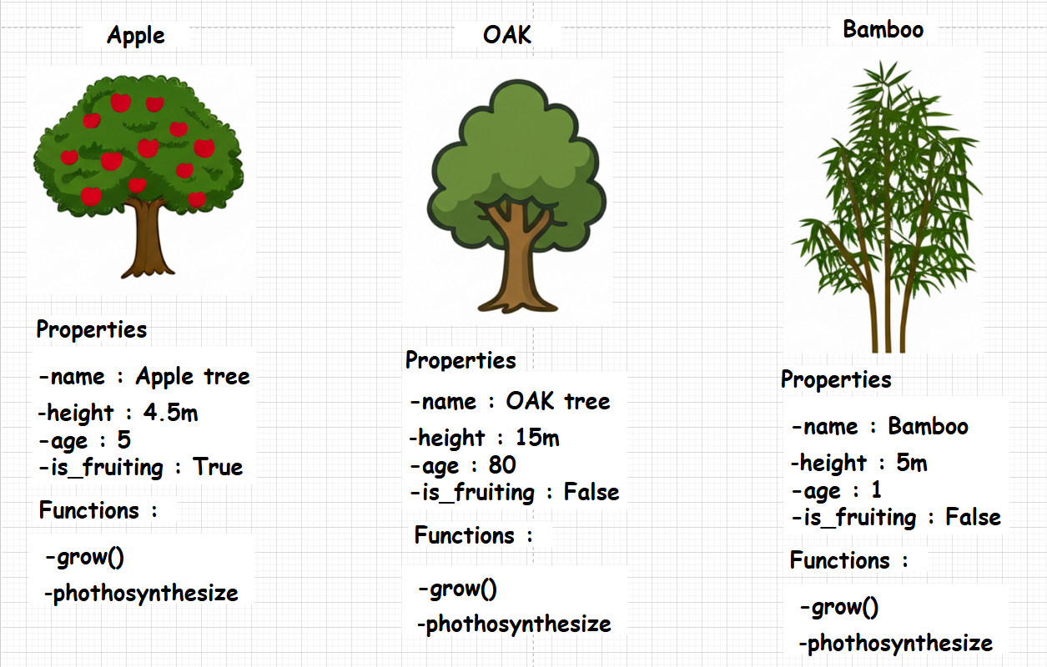
Objects

Slide 5


Techno-freak
"Techno-freak" is an informal term for someone who is intensely interested in and enthusiastic about technology, especially computers and related fields.

Slide 6
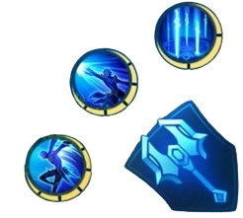
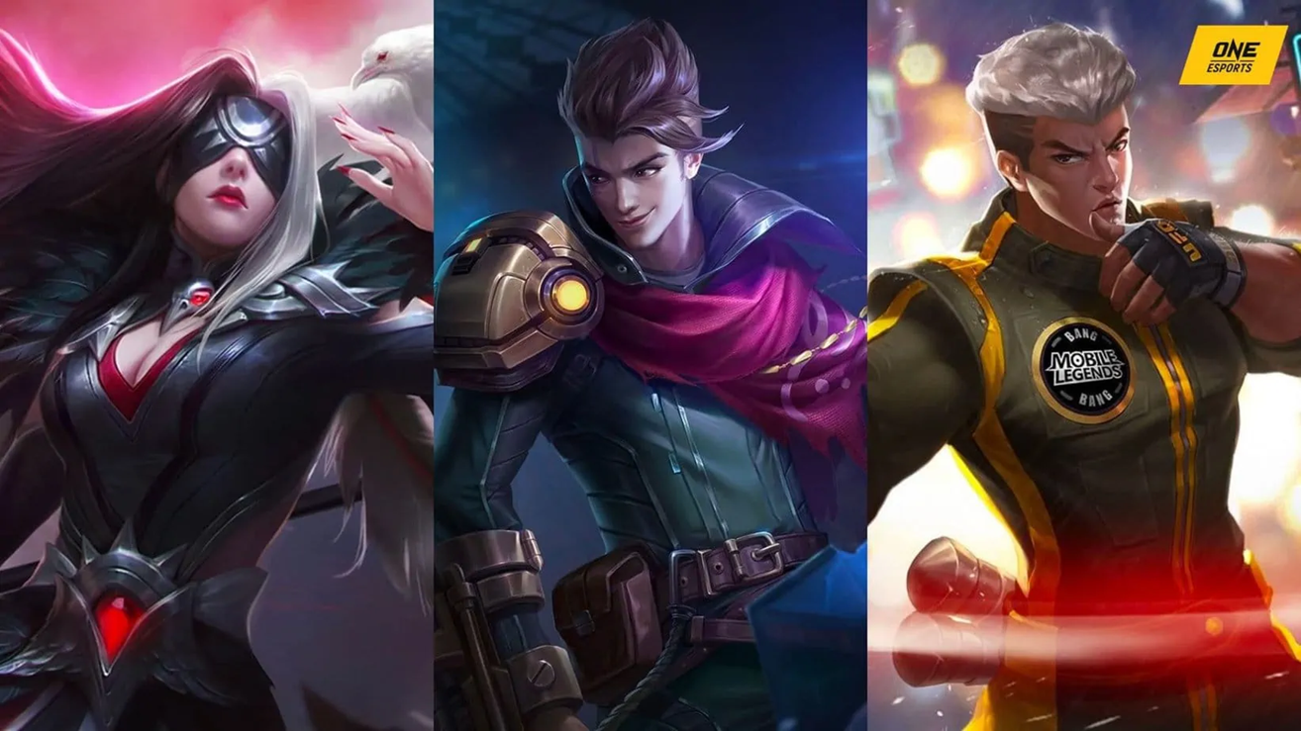

Mobile Legends : MLBB

Slide 7
Classes in MLBB
Properties
Name
Role
walking_speed
Functions
attack1()
attack2()
attack3()

